Slide 1
Flight delay and cancellation omer mazor viz

Slide 2
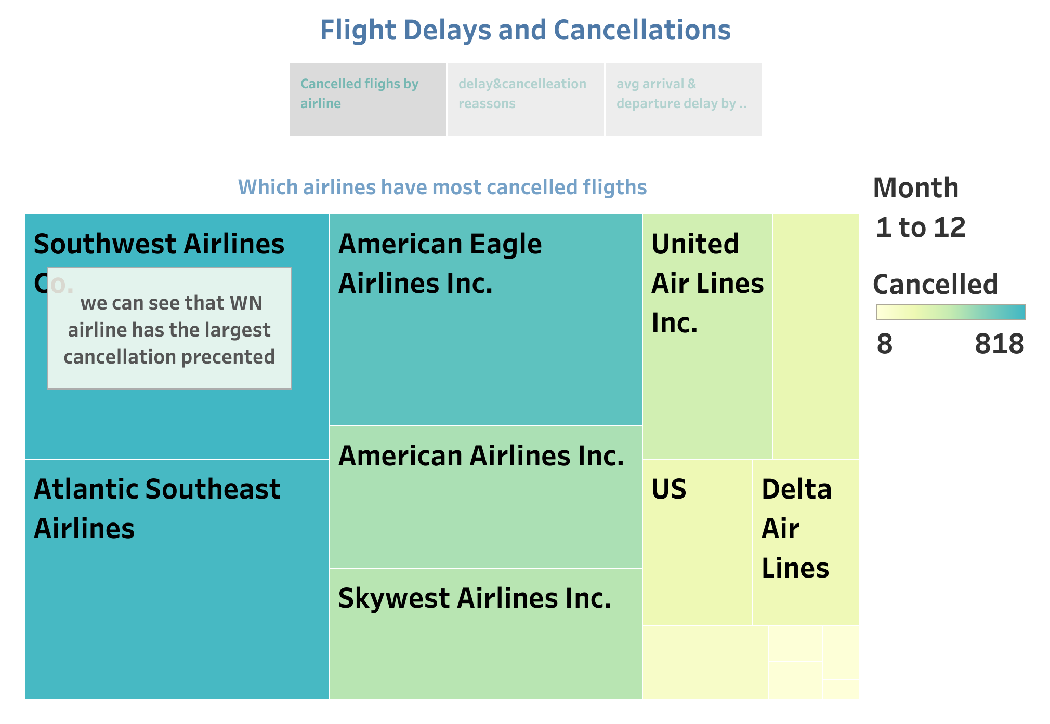

Slide 3
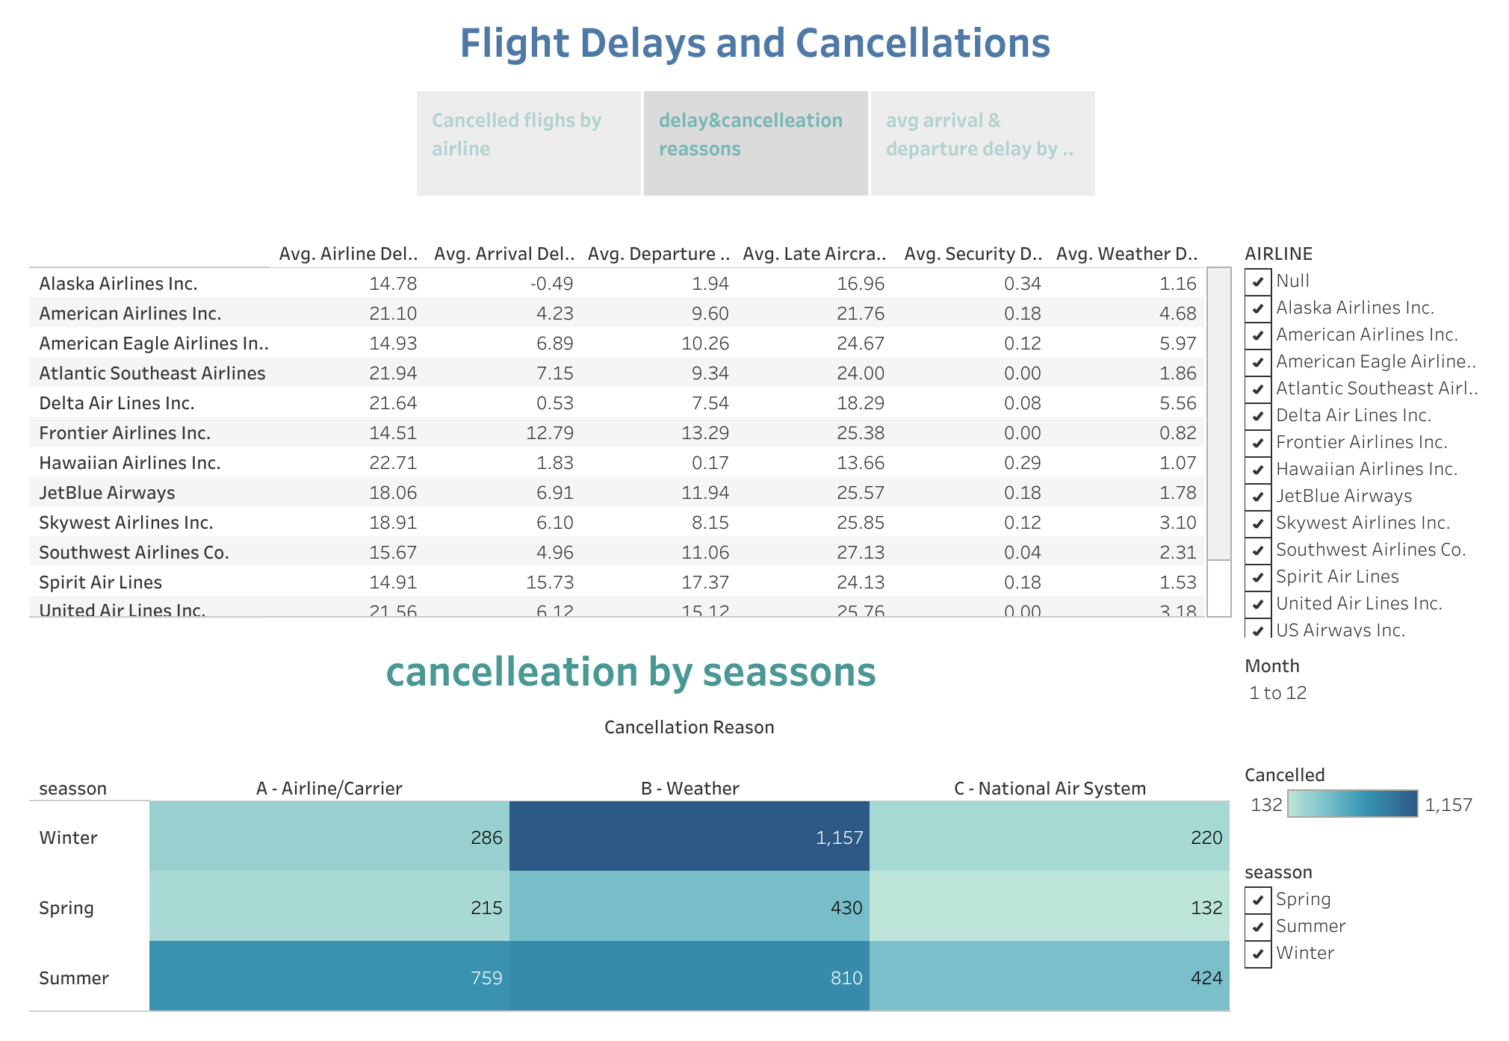

Slide 4
